Slide 1
DIGITAL VOTING SYSTEM

Slide 2
INTRODUCTION
Digital Voting System (DVS) is a web and mobile based application
Description about digital voting system
It consist of groups ,namely-
General Voters.
Candidate/Nominee.
Administrator.

Slide 3
objectives
Implementing a an automate/digital voting system.
Validating the system to ensure that only legible votes are allowed to vote.

Slide 4
scope
Secured login procedure.
Knowing nominees of respective wards
Casting vote is possible only with successful authentication of voter
Abused user can be verified and blocked if necessary
Increasing number of voters as individuals will find it easier and more convenient to vote, especially those abroad.

Slide 5
Requirements
Registration of the voter is done by ELECTION COMMISION OF INDIA.
Voter is given a ADHAR ID and FINGER PRINT AUTHENTICATION
In the DATABASE information of every voter is stored
Database shows the information of every user and by using image processing we have to compare the user finger print with database.
Software requirements: mysql,android,php,javascript,xml, image processing..

Slide 6
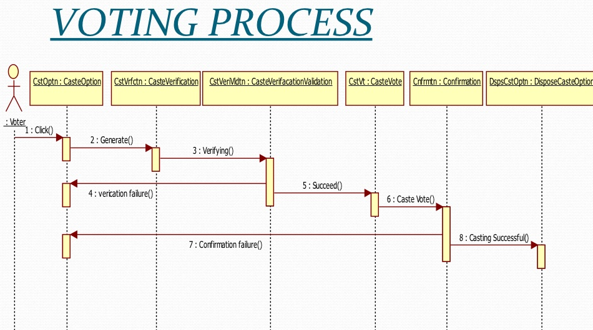

Slide 7
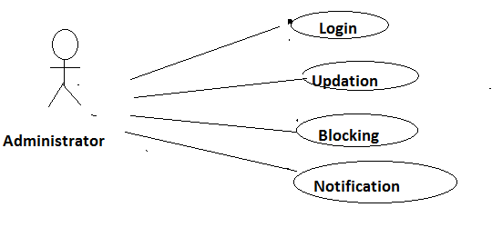
Administrator process diagram

Slide 9
Features
We can vote without rigging.
No one cannot see how the people vote for someone.
No one can wait at polling booths.
Voters use mobile to vote any time any where.
We can conduct voting with in small period of time.

Slide 10
Conclusion:
This digital voting system will manage the voter’s information by which voter can login and use his voting rights.
In this user who is above 18 year’s register his/her information on the database and when he/she want to vote he/she has to login by his Adhar ID and fingerprint authentication and can vote to any party only single time.
Voting detail store in database and the result is displayed by conclusion.It is very less time cosuming.

Slide 11
THANK YOU

